Slide 1
SM
Personal Software Process
for Engineers: Part I
Tutorial: Using PSP0

Slide 2
Tutorial Objectives
After this tutorial, you will
  understand the PSP0 process
  know how to use PSP0 process scripts and forms
  be prepared to use PSP0 for program 1

Slide 3
Before You Begin
The PSP is not the process for writing software.
The PSP is a process for learning about process.
It’s the process equivalent of a code sample.
It works so well for some students that they can use it on the job, but that’s not its intended purpose.
After you’ve completed the course you should
  examine your PSP data
  review your experience and PIPs
  tailor the PSP to meet your needs.

Slide 4
PSP0 Process
PSP0 is a simple, defined, personal process.
  Make a plan.
  Use your current design and development methods to produce a small program.
  Gather time and defect data on your work.
  Prepare a summary report.

Slide 5
PSP0 Objective
The objective for PSP0 is to
  demonstrate the use of a defined process in writing small programs
  incorporate basic measurements in the software development process
  require minimal changes to your personal practices

Slide 6
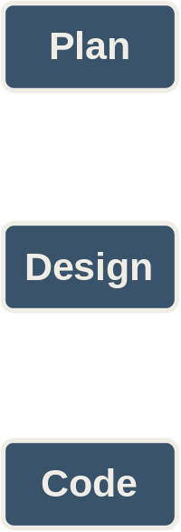
PSP0 Process Phases -1
PSP0 has six phases.
Planning – produces a plan for developing the program defined by the requirements.
Design – produces a design specification for the program defined by the requirements.
Coding – transforms the design specification into programming language statements.

Slide 7
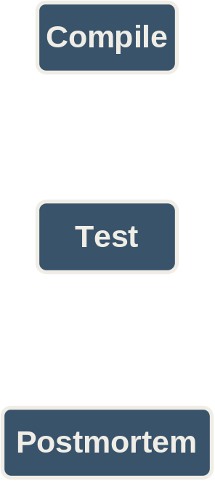
PSP0 Process Phases -2
Compile – translates the programming language statements into executable code.
Test – verifies that the executable code satisfies the requirements.
Postmortem – summarizes and analyzes the project data.

Slide 8
Phase Order
The PSP looks like a waterfall process but it’s not.
The phase order is determined by the dependencies between phases.
  You can’t test the code before it’s compiled.
  You can’t compile the code before it’s written.
  You can’t use the design if it’s produced after the code is written.
  There’s no reason to make a plan after you’re done.
Conclusion…start here with a plan.
Test
Compile
Code
Design
Plan

Slide 9
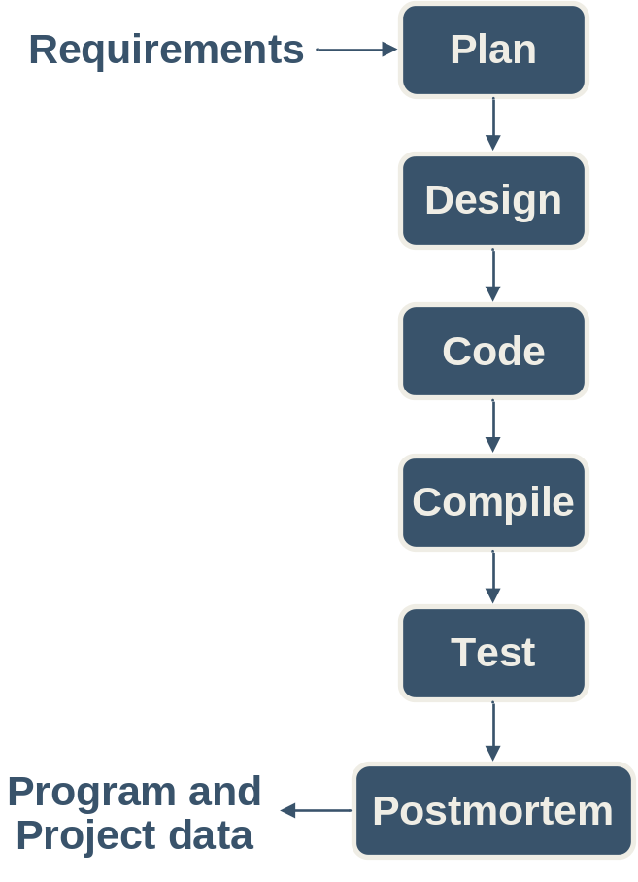
Process Flow
When programs are small or well understood, you can execute the phases in order.
Produce a plan.
Design all modules.
Code all modules.
Compile the coded program.
Summarize the project data during the postmortem.

Slide 10
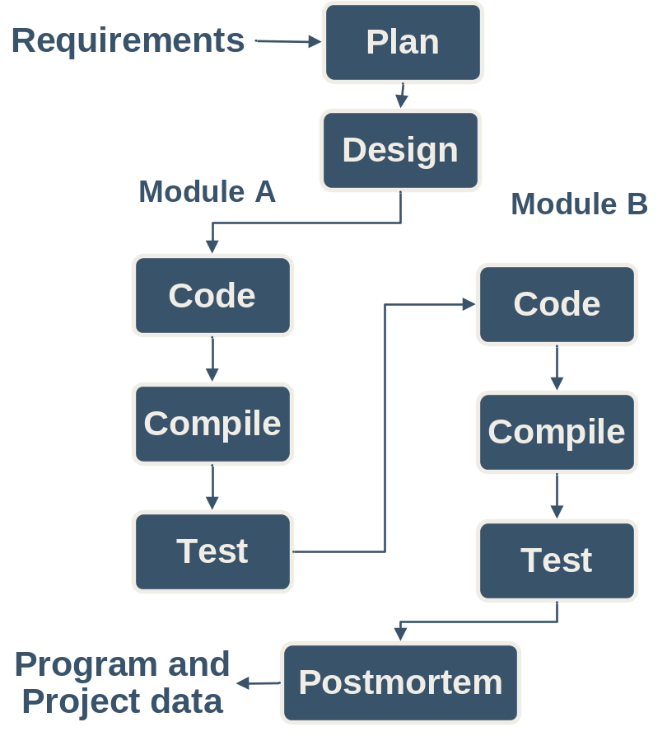
Cyclic Process Flow -1
Large programs or those that are not well understood may require an iterative approach.
In this example the design is completed in one step.
Two modules are identified during the design, modules A and B.
Then each module is separately coded, compiled, and tested.
This example uses the PSP0 phases and two cycles of code-compile-test.

Slide 11
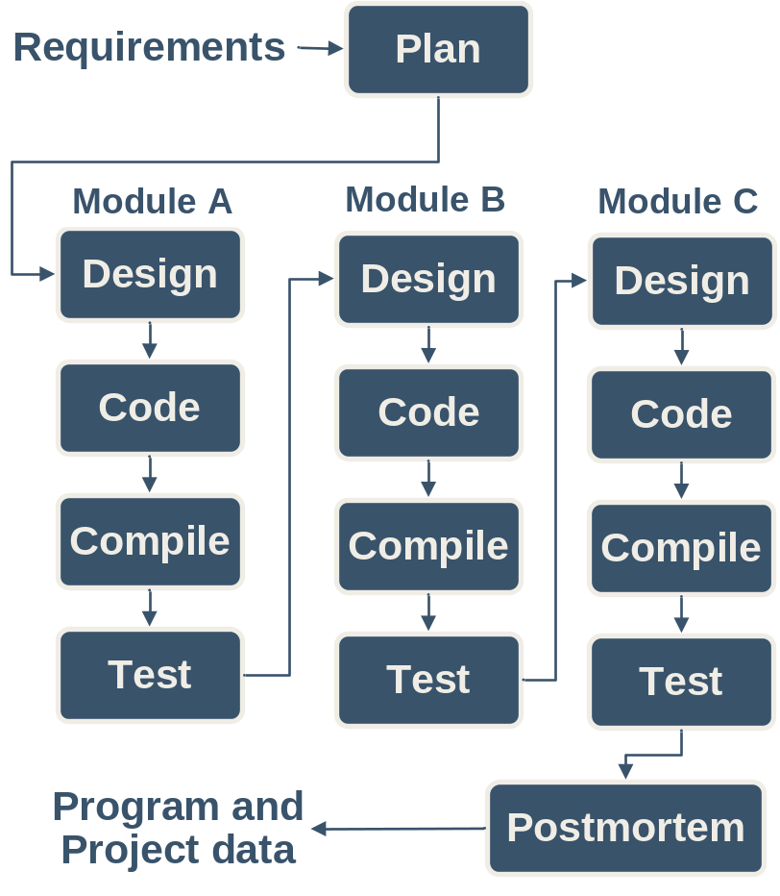
Cyclic Process Flow -2
There can be more than two cycles and cycles can also include the design phase as in this example.
Note that each cycle is focused on producing part of the program, e.g. Module A, Module B, Module C.
Part size is a key factor for determining cycles.
  a line of code is too small
  a program may be too large
One or more classes, methods, procedures, or functions are probably the right size.
You need to determine what works for you.

Slide 12
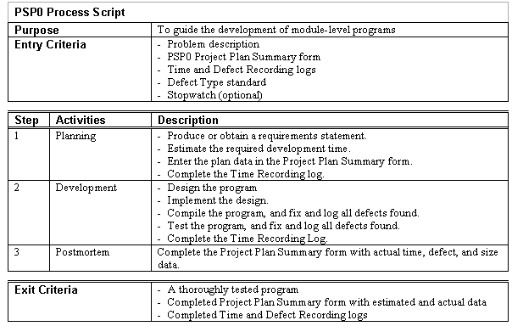
Process Scripts
Process scripts provide “expert-level” guidance on how to use the process.
They are one or two pages long.
They describe the
  Purpose
  Entry criteria
  General guidelines
  Steps
  Exit criteria

Slide 13
The PSP0 Scripts -1
Planning: Estimate the development time.
Development: Develop the product using your current methods.
Postmortem: Complete the project plan summary with the time spent and defects found and injected in each phase.

Slide 14
The PSP0 Scripts -2
Design: Design the program using your current design methods.
Coding: Implement the program.
Compile: Compile until defect-free.
Test: Test the program and fix all defects.
Record defects in the defect log and time per phase in the time log.

Slide 15
Using Process Scripts
Process scripts guide you through the process.
You should
  check the entry criteria before starting a phase
  record the phase start time
  perform the phase steps and instructions
  record defects as they are found and corrected
  check the exit criteria before ending a phase
  record the phase end time
  go to the next phase
Force yourself to use this paradigm until it becomes a habit.

Slide 16
PSP0 Measures and Forms
PSP0 measures
  Time – track time in phase
  Defects – record defects as they are found and fixed
PSP0 has four forms
  PSP0 Project Plan Summary – summarizes planned and actual time and defects by phase
  PSP0 Time Recording Log – used to record time
  PSP0 Defect Recording Log – used to record defects
  PSP0 Defect Type Standard – used to define standard defect types

Slide 17
PSP Student Workbook
The PSP Student Workbook provides support for the PSP.
  scripts
  forms
  measures
  calculations
  planning
  tracking
  quality management
  analysis
  historical data
  access to class materials
It also provides support for post-course use of the PSP.

Slide 18
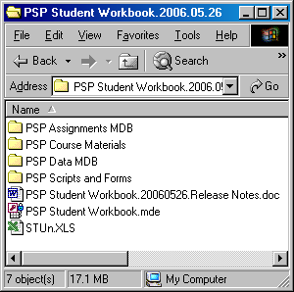
Installing the PSP Student Workbook
Create a folder to hold the contents of the student CD.
Copy the contents of the CD to this folder.
Contents
  PSP Assignments MDB
  PSP Course Materials
  PSP Data MDB
  PSP Scripts and Forms
  PSP Student Workbook
  Release notes
  Excel spreadsheet STUn.xls

Slide 19
What’s in the Folder
PSP Assignments MDB – a folder containing backup copy of assignment data used to submit assignments electronically.
PSP Course Materials – a folder containing the lectures, assignment kits and tutorials for the class.
PSP Data MDB – a folder containing a backup database where you can save your data.
PSP Scripts and Forms – a folder containing the PSP scripts and forms.
PSP Student Workbook – the PSP student workbook
Release notes – release notes for the current version of the PSP student workbook.
Excel spreadsheet STUn.xls – a spreadsheet for submitting student data to your instructor.

Slide 20
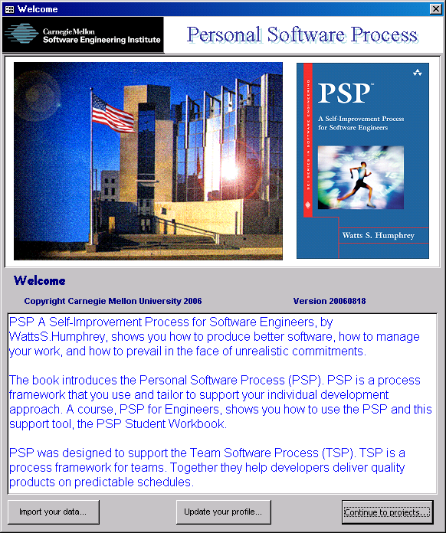
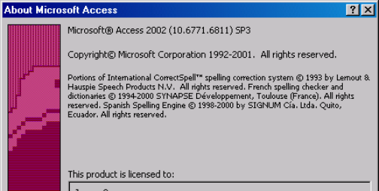
Open the PSP Student Workbook
To use the PSP Student Workbook you will need Microsoft Access 2002, service pack 3 or above.
Next, open the PSP Student Workbook.
When it opens you will see the Welcome Form.

Slide 21
Open the PSP Student Workbook
The welcome has three buttons near the bottom of the form.
Import your data… is used to import data from a previous version of the workbook when updating.
Update your profile… is used to update your student profile.
Continue to projects… takes you to the main form.
Click Continue to projects… to create your student profile and open the main form.

Slide 22
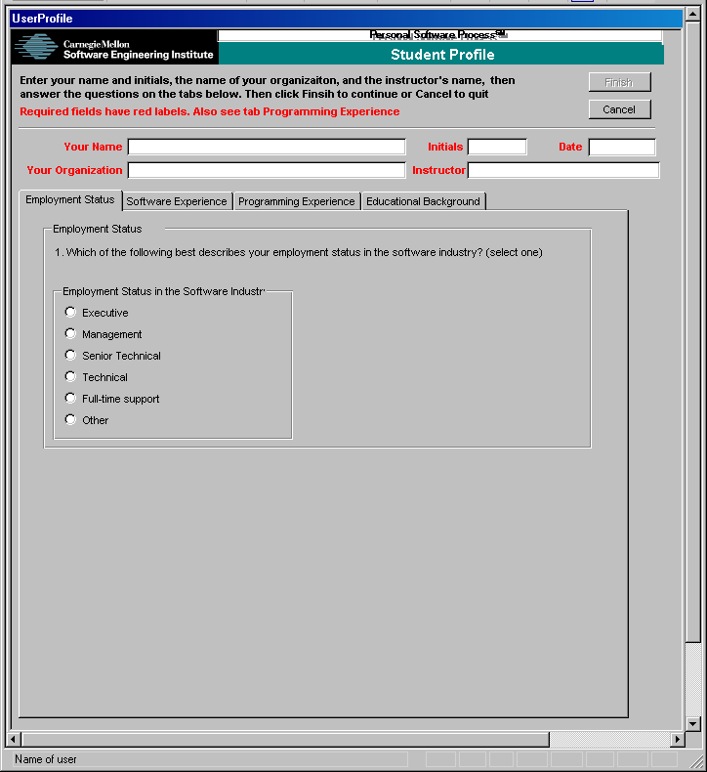
Complete the Student Profile
Enter the following
  name
  initials
  date
  name of your organization or company
  name of the lead instructor
Answer the questions under each tab.
  employment status
  software experience
  programming experience
  educational background
Click Finish…the main PSP Student Workbook form will open.

Slide 23
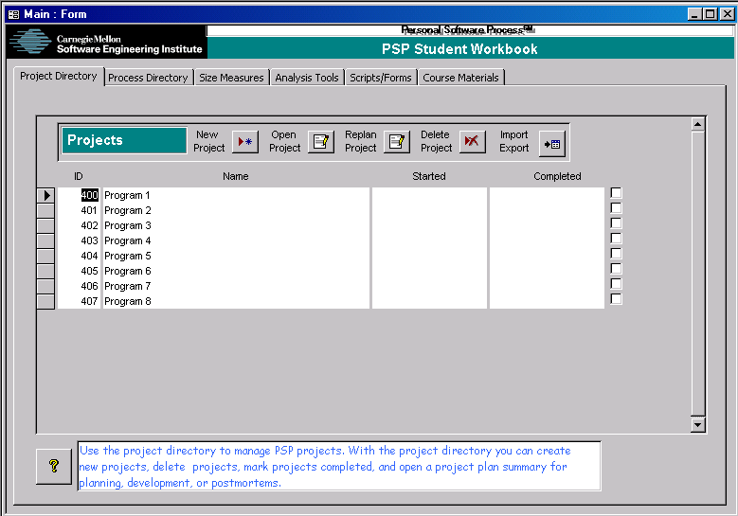
PSP Student Workbook
The PSP student workbook main form provides access to
  Projects
  Processes
  Size measures
  Analysis tools
  Scripts/forms
  Course materials

Slide 24
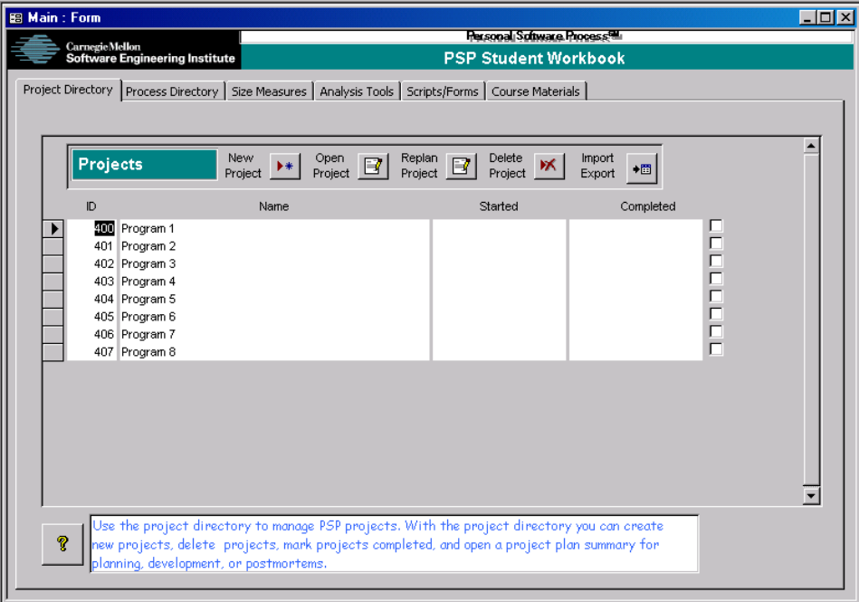
Project Directory
Use this tab to
  create new projects
  open projects
  replan projects
  delete projects
  import/export data
  mark projects completed

Slide 25
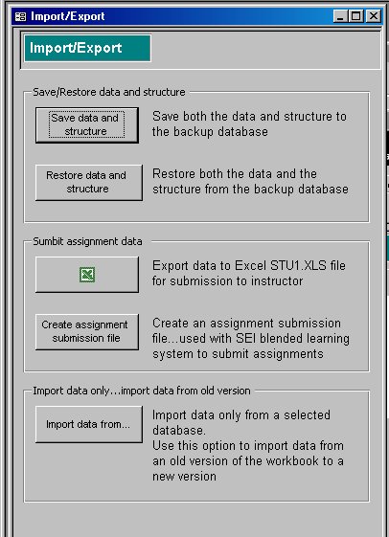
Import/Export
Use this form to save and restore data and structure to the backup database
You can also use this form to submit assignment data to your instructor using one of two options
  Export data to the included STUn.XLS file and provide your instructor with a copy of this file.
  Create an assignment submission file for use with the SEI blended learning system.
You can also use this form to import data when upgrading to a newer version of the PSP Student Workbook.

Slide 26
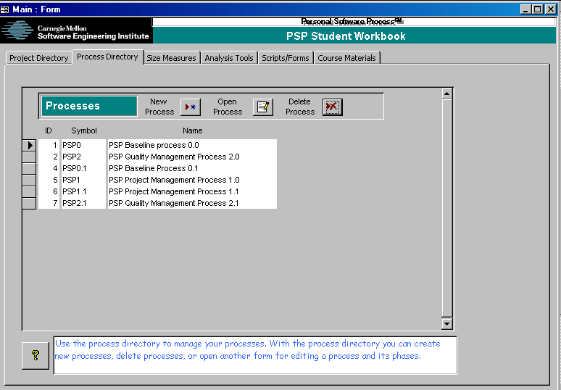
Process Directory
Use this tab to
  create new processes
  open processes
  delete processes

Slide 27
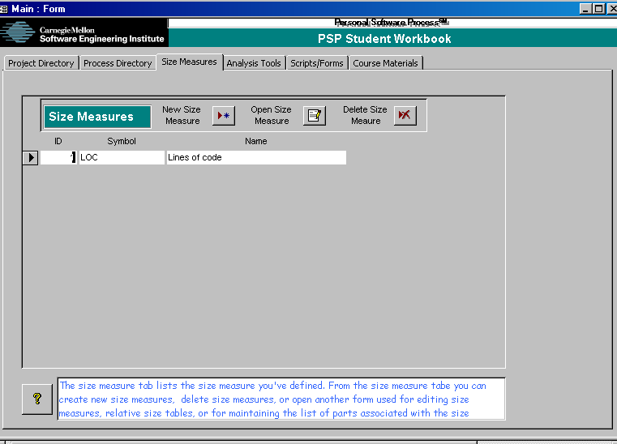
Size Measures
Use this tab to
  create new size measures
  open size measures
  delete size measures

Slide 28
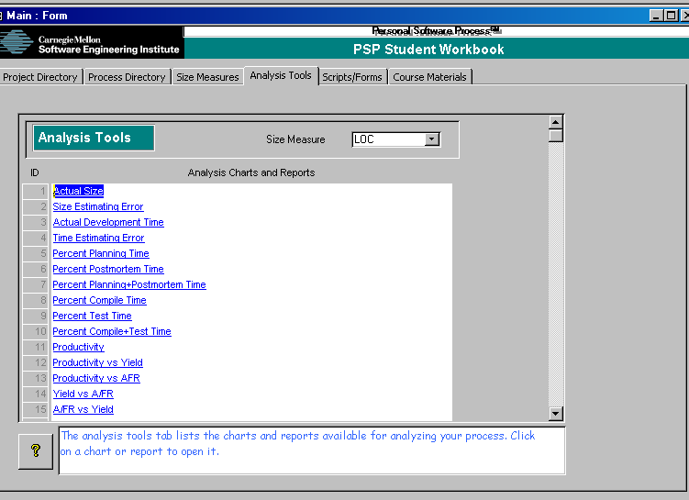
Analysis Tools
Use this tab to analyze your data.
Analysis tools include
  productivity
  actual program size
  actual time
  estimation error
Click on any of the 42 hyperlinks to open the corresponding tool.

Slide 29
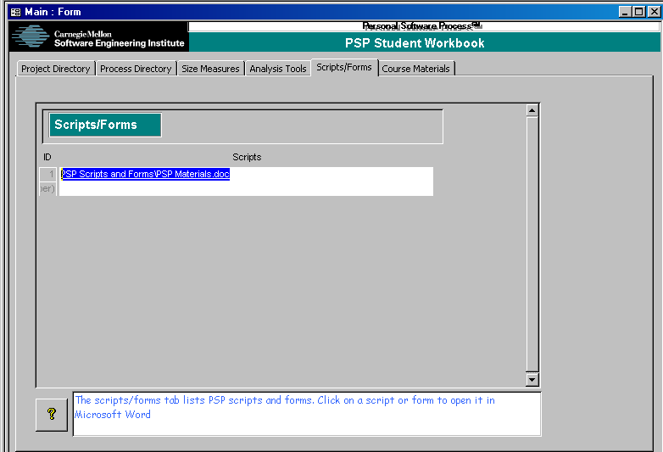
Scripts/Forms
Use this tab to open the word document(s) containing the PSP scripts and forms.
Click on a hyperlink to open the document.

Slide 30
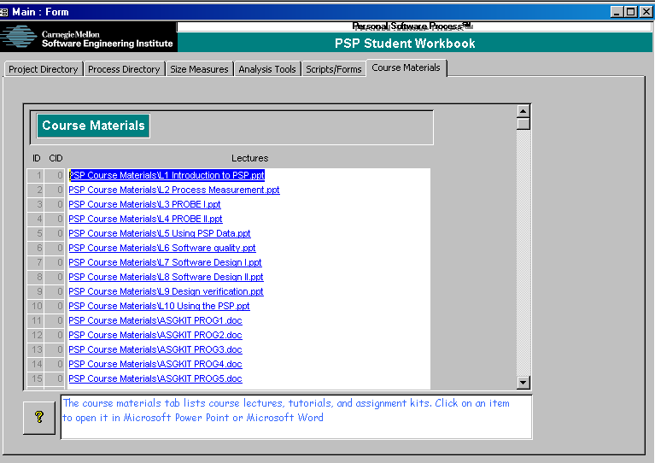
Course Materials
Use this tab to open the course materials
Click on a hyperlink to open the document.

Slide 31
Back to the Project Directory -1
There are eight assignments in the course.
Each assignment is a project.
To execute an assignment you will
  open the corresponding project
  use the forms provided to plan it
  track it using the time log and defect log forms
  conduct a postmortem when the project is finished
  mark it completed

Slide 32
Back to the Project Directory -2
The project directory displays the
  Project name
  Start date
  Completed date
  Completed checkmark
Note…
  The course assignment projects must be completed in order.
  The names of these projects should not be changed.
  Mark them complete only when you’re absolutely certain that you’ve entered all data correctly.

Slide 33
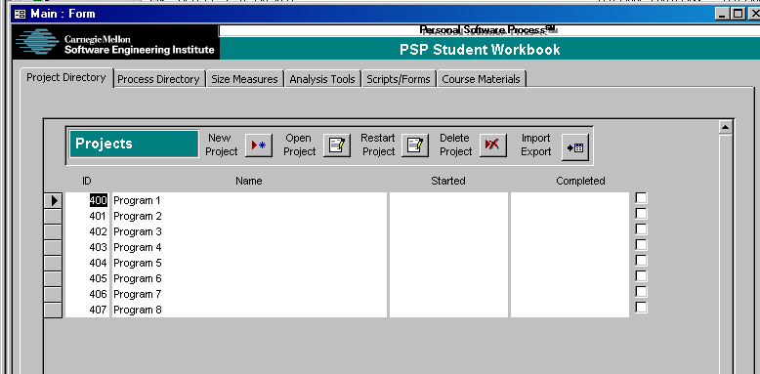
Getting Started: Opening a Project
Select the first project, Program 1
  Click the record selector
  Click a field in the record
Click the Open Project button.
Record selector
Field
Open project
UI Facts and Shortcuts
  Move to next field in form…<tab>
  Move to prior field in form… <shift><tab>
  Move to next subform within a form… <ctrl><tab>
  Move to prior subform within a form… <ctrl><shift><tab>
  Delete field contents when selected… <del>
  Undo delete field… <esc>
  Enter current date…<ctrl>;
  Enter current time… <ctrl>:
  Enter copy of field from same field in previous record… <ctrl>”
UI Facts and Shortcuts
  Delete record… click record selector and <del> or use provided button
  Selected record… an arrow in the record selector
  Editing record or starting new record… a pencil in the record selector
  Undo edit or new record… hit esc until pencil disappears.

Slide 34
Opening a Project
The PSP uses historical data as an aid to planning, you will learn more about this during the class.
The historical data are data from completed projects.
  Time
  Size
  Defects
When you open a project, a summary snapshot of this data is created and stored with the project.
Changes to data on earlier projects will not affect a later project after it has been opened.
NOTE: The Replan Project button will recalculate the historical data for the selected project using data from all projects that were completed before the selected project started.

Slide 35
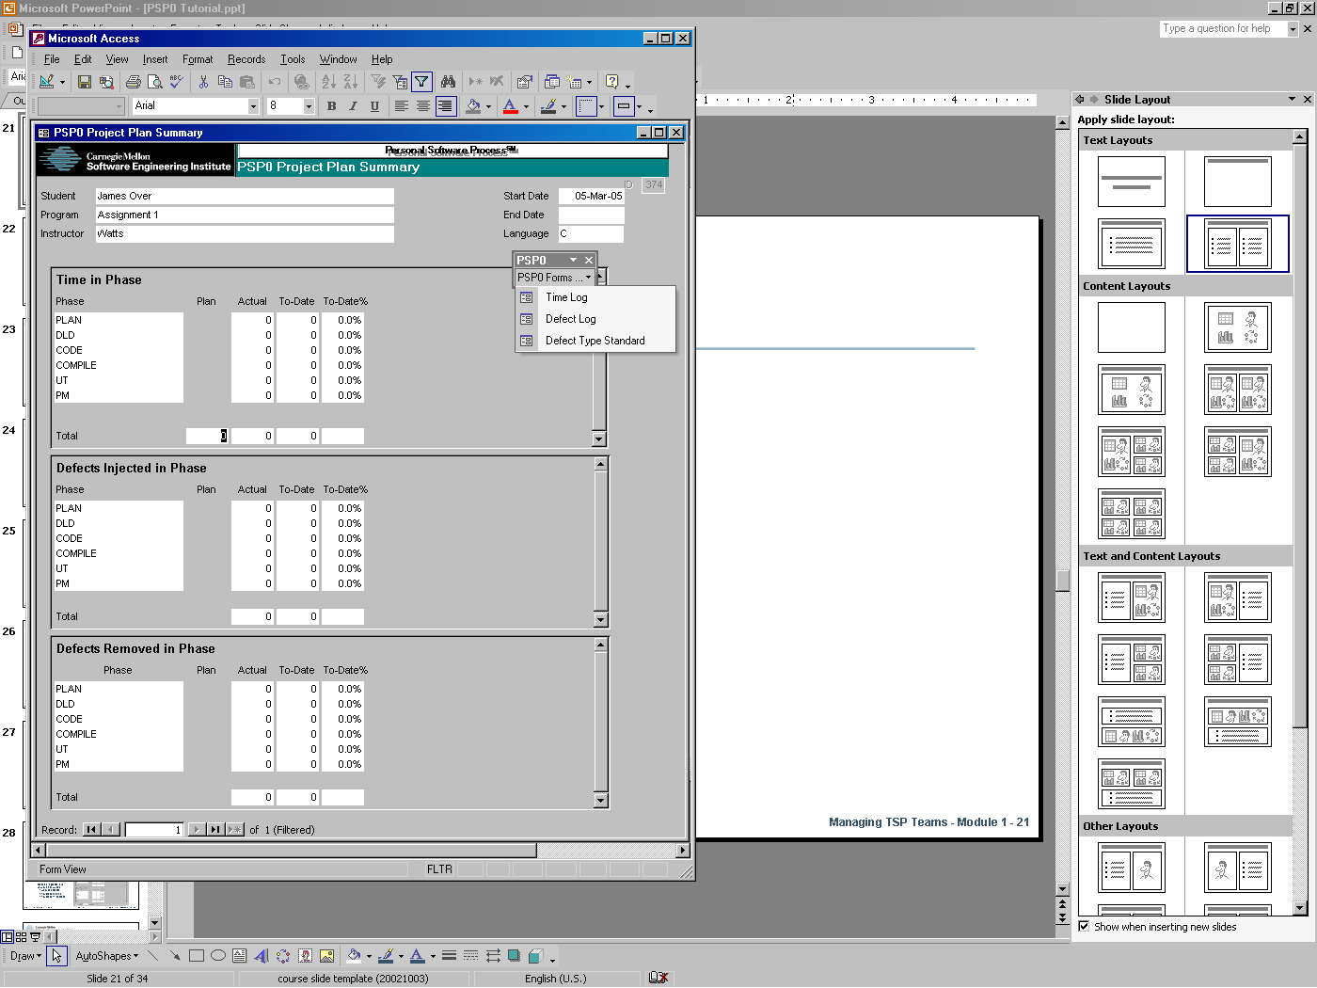
PSP0 Forms -1
This is the PSP0 Project Plan Summary.
To open the other PSP0 forms click PSP0 Forms… on the PSP0 menu.
Select the form to open
  Time Log
  Defect Log
  Defect Type Standard

Slide 36
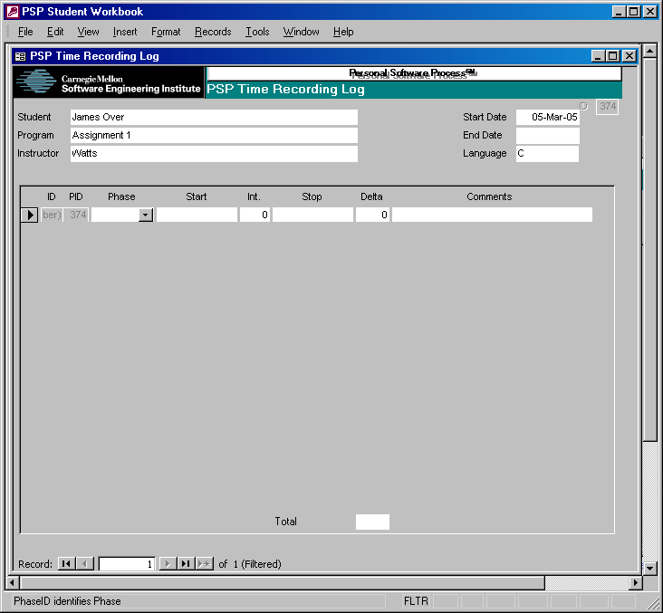
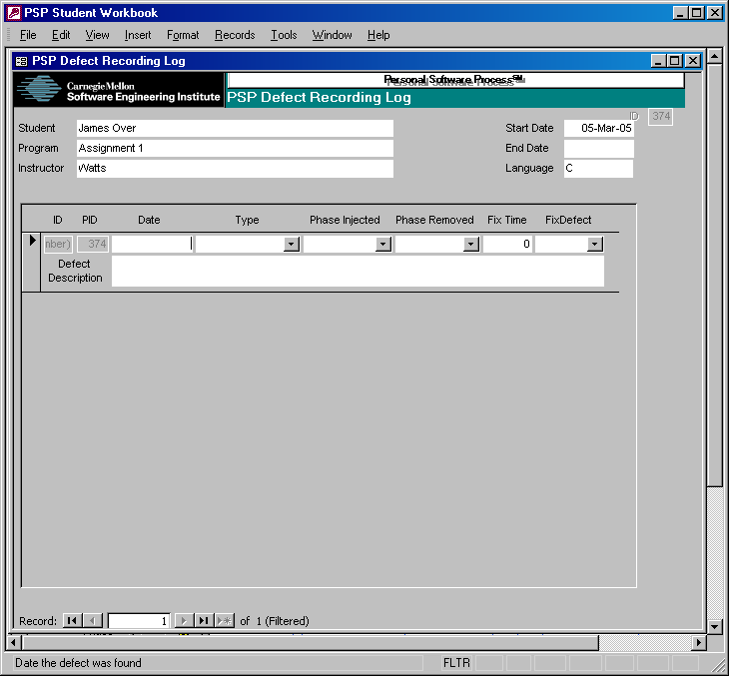
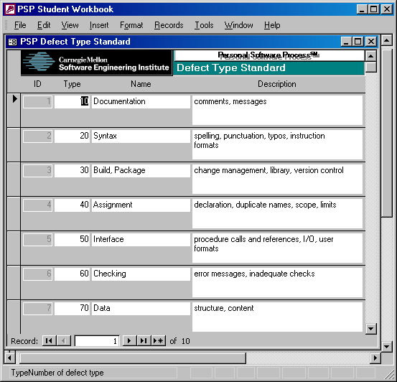
PSP0 Forms -2

Slide 37
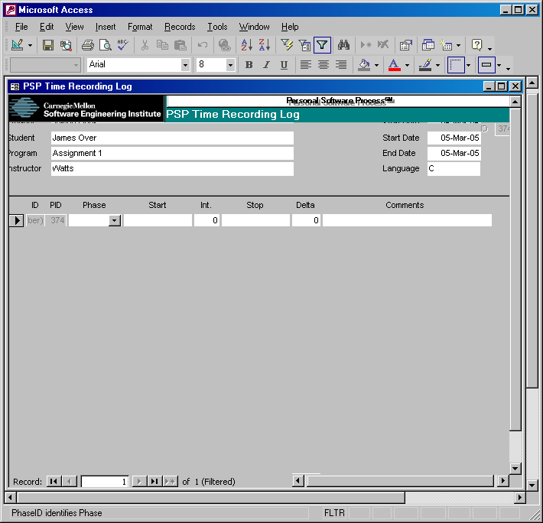
PSP0 Time Recording Log -1
Phase: Select the phase on which you were working.
Start: Enter the date and time you started working. Double click to enter the current date and time or type <ctrl>;<space><ctrl>:
Int.: Enter any interruption time in minutes.

Slide 38
PSP0 Time Recording Log -2
Stop: Enter the date and time you stop working. Double click to enter the current date and time.
Delta Time: The delta time is calculated automatically.
Comments: Use to describe any interruption, the task you were doing or anything else that significantly affects your work

Slide 39
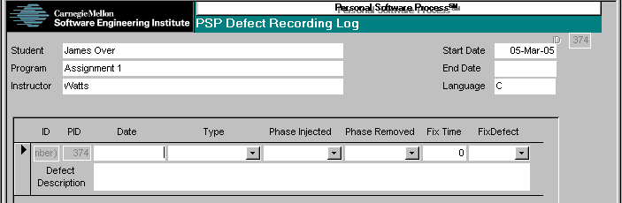
Defect Recording Log -1
Type: Select the defect type
Date: Enter the date the defect was found. Double-click to enter the current date.
Phase Injected: Select or enter the phase during which you judge the defect was injected.
Phase Removed: Enter the phase during which you found and fixed the defect.

Slide 40
Defect Recording Log -2
Fix time: Enter the time that you took both to find and fix the defect. You may time it exactly, or use your best judgment.
Fix defect: If this defect was injected while fixing another defect, enter the number of that defect.
Description: Enter explanation of what the defect was (not the symptom, but the defect!).

Slide 41
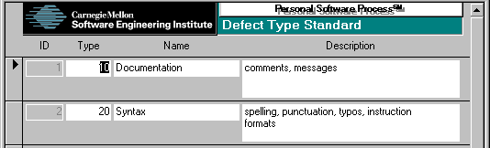
Defect Type Standard
The defect type standard provides a general set of defect categories.
While you may add items or replace this standard with your own, it is generally wise to stick with these simple definitions until you have data to guide your changes.

Slide 42
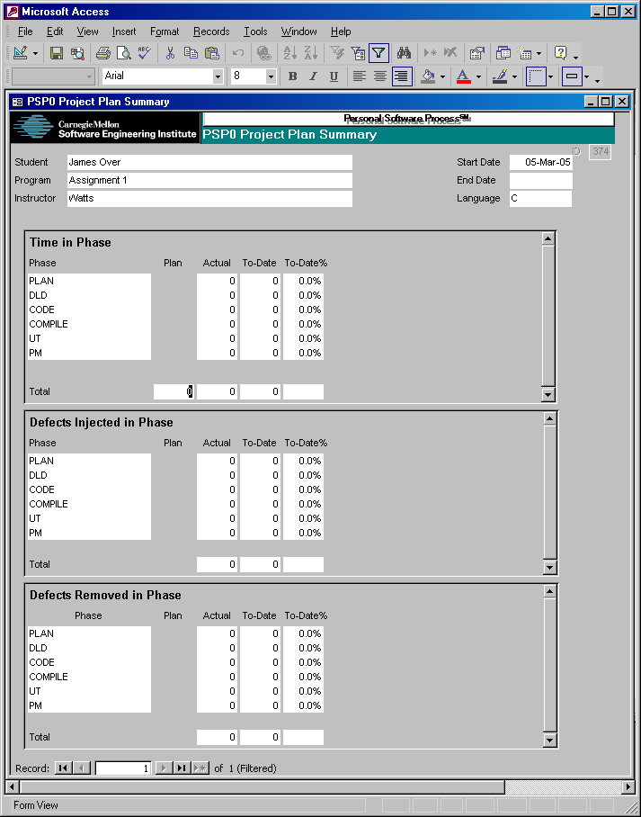
PSP0 Project Plan Summary
Enter your best estimate of the total time that the development will take.
The remaining items are calculated automatically.
Time in phase
  Actual time
  To Date time
  To Date % time
Defects injected and removed in phase
  Actual defects
  To Date defects
  To Date % defects

Slide 43
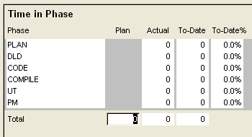
Project Plan Summary Update
Starting with version 20061007, all fields that the student enters data in are formatted as shown.

Slide 44
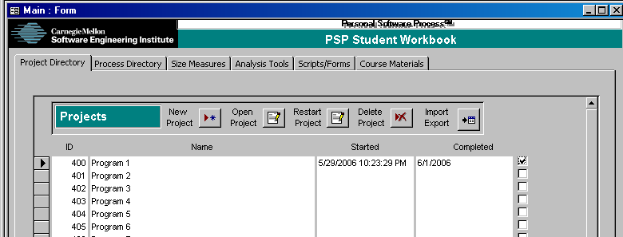
Completing a PSP Project -1
Select the project, e.g. Assignment 1.
Enter a date in the completed fields or click the completed checkbox to enter today’s date.

Slide 45
Completing a PSP Project -2
Some notes on completing a project…
  Each project’s plan is based on historical data from prior projects.
  When a project is first opened, it takes a snapshot of the current historical data for use in planning.
  If these data are in error, the plan will be in error.
  With the limited data available in the course, projects are prevented from being opened until the prior project is completed.
  You must still do your part and make sure that the project data are complete and self-consistent before marking a project complete.
  If you’re not sure that your data are right, don’t guess…check the text or ask an instructor.

Slide 46
Some Common Errors
The following are common errors students make.
  Not tracking time in planning and postmortem
  Skipping phases or executing phases out of order
  Omitting some defects found in compile or test
  Forgetting to record the measured actual size of programs developed (PSP1.x and above)
  Confusing phases with activity, e.g. counting time spent re-designing or re-coding during test as design time or coding time.
The next few slides address some specific problems with time and defect tracking.

Slide 47
Defect Fix Time
Defect fix time is often misunderstood.
It is the time taken both to find and fix the defect.
Example
8:05 run compiler on p1a.c, “line 23 - type mismatch”
8:06 run editor on p1a.c
8:15 change declaration on line 6 from integer to real
8:16 run compiler on p1a.c, “no errors”
Q: What is the defect fix time?
A: 10 minutes

Slide 48
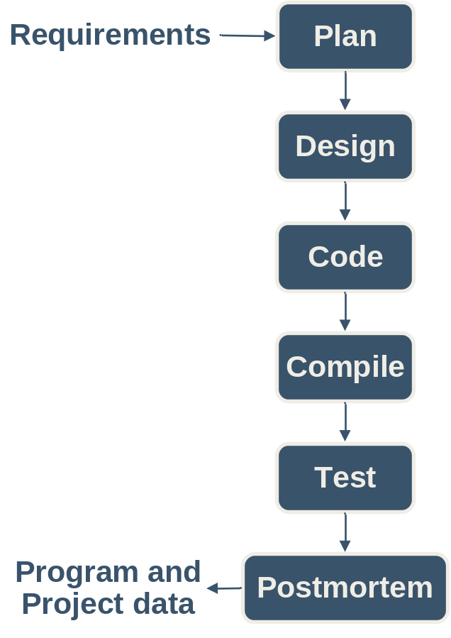
Defect Phase Injected
The injected phase for a defect depends on the phase the program is in.
Example:
Tom finds a major logic error in his program during test. He has to redesign and code part of his program.
Q: What phase is Tom’s program in?
A: Test
Tom finds a defect in the new code he has written.
Q: In what PSP phase was the defect injected?
A: Test

Slide 49

Measurement in the Cyclic Process
Considerations
  Include a program part identifier in the notes field on time log entries.
  Add a similar annotation to defect log entries.
  Use “Test” as the phase removed when defects are found in a previously tested part.
Example
Tom finds and fixes an interface error in part A of his program while coding part B.
Q: In what PSP phase was this defect removed?
A: Test

Slide 50
Measurement Hints
Gather and record data on your process as you work, not afterwards. If you forget, promptly make your best guess.
Be precise and accurate.
  Track time in minutes.
  Count every defect.
You will be using your own data to manage your process; gather data that is worthy of your trust.

Slide 51
Messages to Remember
In using PSP0, your principal objective is to learn to gather and report accurate and complete data on your work.
Once you have completed this course, you will know how to adjust and extend the PSP to meet your future needs.
Until then, make your best effort to follow the PSP process scripts and instructions.

